Slide 1
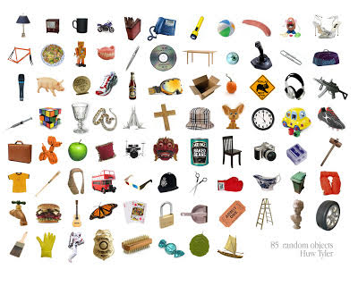
OBJECT RECOGNITION
TEAM-
GUNJAN ASRANI
MANISH CHAUDHARI

Slide 2
OUR MAJOR CONTRIBUTION
Our main focus was to research on the object detection of different categories as well as recognize them.
We considered three test cases:
1. Detection of objects of red colour in a LIVE video sequence.
2. Object detection and recognition in a cluttered scene.
3. Detection and recognition of a single object in different categories.

Slide 3
INTRODUCTION
It is task of finding and identifying objects in an image or a video sequence.
Like Human Understanding, it includes:
Detection- of separate objects
Description- of their geometry and positions in 3D
Classification- as being one of a known class
Identification- of the particular instance
Understanding- of spatial relationships between objects

Slide 4
OBJECT RECOGNITION CATEGORIES
Geometry-based approach
Appearance-based approach
Feature-based approach

Slide 5
Geometry-based approach
Focused on Geometric description of 3D object
- allows the shapes to be accurately predicted in a 2D image projection using edge or boundary information.
Used to extract geometric primitives that are invariant to viewpoint change.

Slide 6
Appearance-based approach
To compute eigenvectors from a set of vectors
- Each vector represents one face image as a scan vector of various pixels.
- Each eigenvectors captures certain variance among all vectors.

Slide 7
Feature-based approach
Focused on finding interest points, occurring at intensity discontinuity that are invariant to change.
SIFT (Scale-invariant feature transform) approach extracts features insensitive to certain scale and illumination change.
SIFT based methods are expected to perform matching algorithms and indexing for effective object recognition.

Slide 8
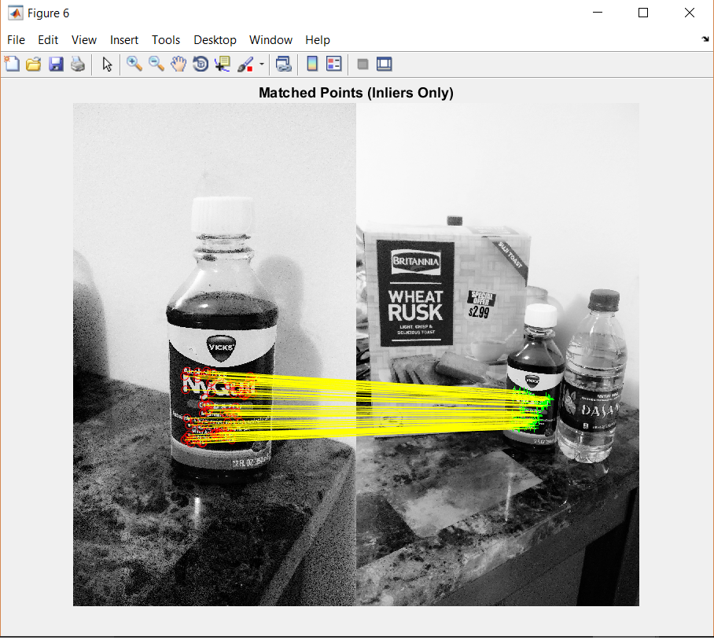
FEATURE MATCHING CONCEPT
Effective object detection must be able to handle cluttered scenes, changes to the object size, location, orientation and other challenges.
Computer Vision System Toolbox offers a variety of techniques for handling challenges in object detection.

Slide 9
FLOW
Read Images
Detect Features Points
Extract Feature Descriptors
Find Putative Point Matches
Locate Object in the Scene

Slide 10
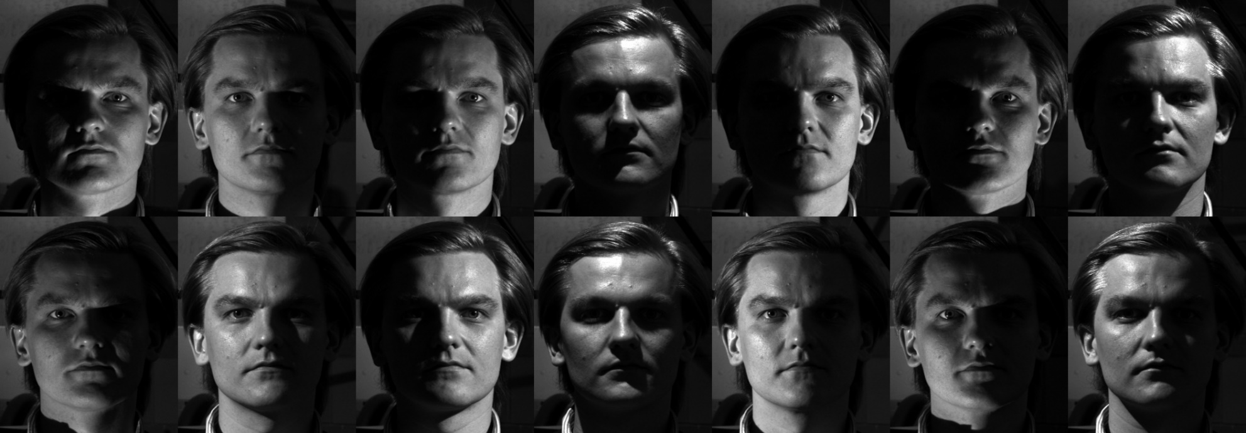
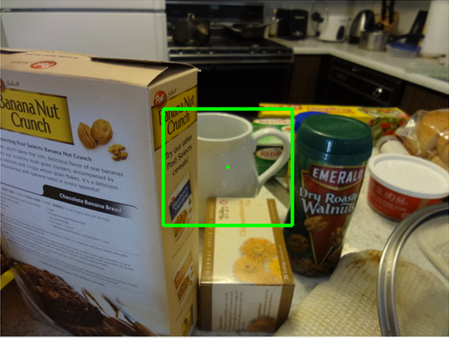
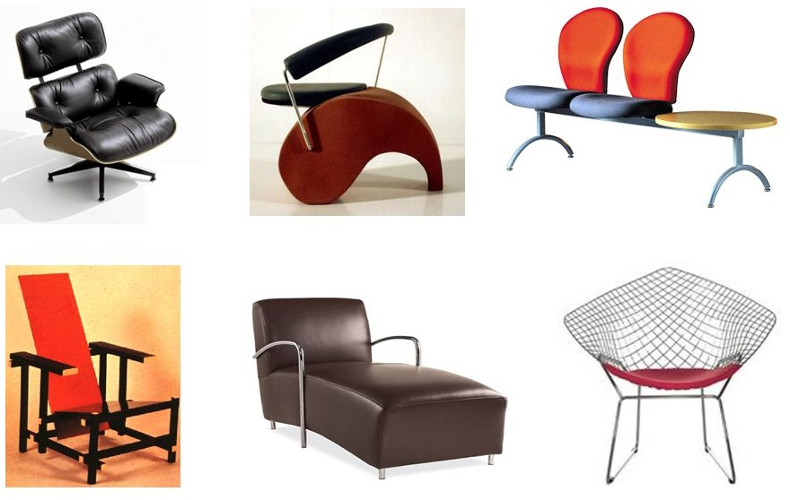
COMMON PROBLEMS
Large variation in illumination
Heavy Occlusion
Intra-class variation

Slide 11
EXPERIMENTAL RESULTS
-We conducted our experiment on 101 data set of object categories.
-Each experiment was carried out under identical conditions.
-For each category dataset, 50 images are drawn for the training and testing data set, followed by feature extraction and unique point feature matching.
-If more feature point matches, more is the accuracy and similarly if less feature point matches, less is the accuracy.
Category | Accuracy
Objects in a cluttered scene | 100%
Single object | 64%

Slide 12
DATA SETS
CalTech data sets:
http://www.vision.caltech.edu/html-files/archive.html
Well recognized Data set
101 Different categories of Images
From 40 to 800 images per category

Slide 13
CONCLUSION
We analysed the complexity and easiness in object detection and recognition in a cluttered scene as well as of individual ones in different categories.
Detection and recognition is based on the feature extraction and accuracy is based on the number of matches of feature points between testing and training images.
More the number of feature point matches, more is the accuracy.

Slide 14
REFERENCES
[1] D. Jugessur and G. Dudek. Local appearance for robust object recognition. In Computer Vision and Pattern Recognition.
[2] L. Fei-Fei, R. Fergus and P. Perona, “A Bayesian approach to unsupervised learning of object categories’, Proc. ICCV, 2003.
[3] I. Biederman, “Recognition-by-Components: A Theory of Human Image Understanding.” Psychological Review, vol. 94, pp.115-147, 1987.
[4] Y. Amit and D. Geman, “A computational model for visual selection”, Neural Computation, vol. 11, no. 7, pp1691-1715, 1999.

